Slide 1
Pet Feed
Group 8

Slide 2
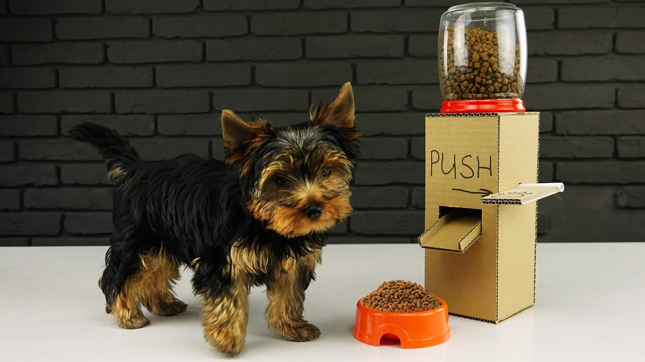
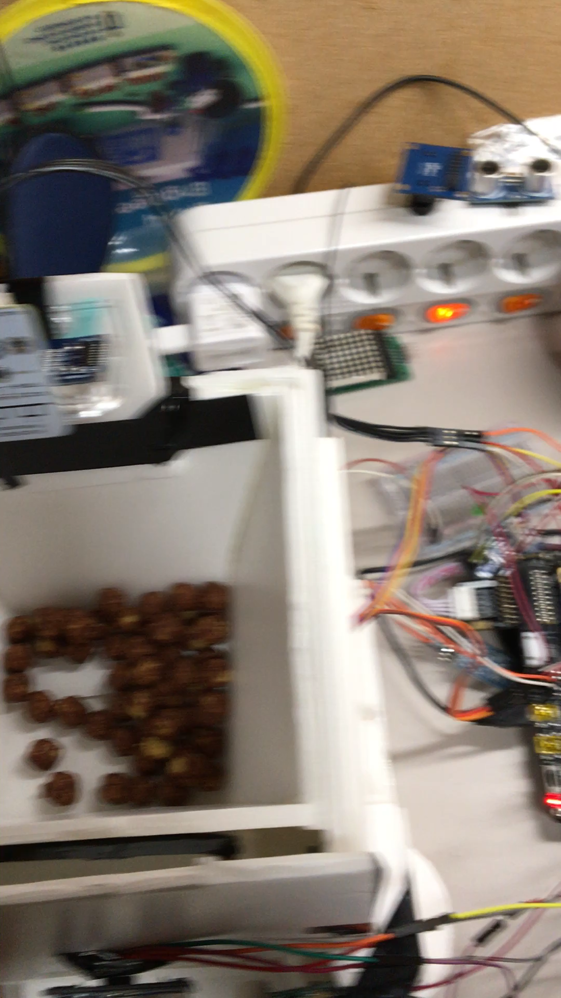
Demo Time

Slide 3
User sets time for dispense
Swipe motion for dispense
Manual movement of plate
Pet food dispensed
Plate moves for cleaning
Buzzer goes on to alert the pet
Pet is near the food
Pet is approaching the food
Buzzer Stops & Pet enjoys the food
Left-over check

Slide 4
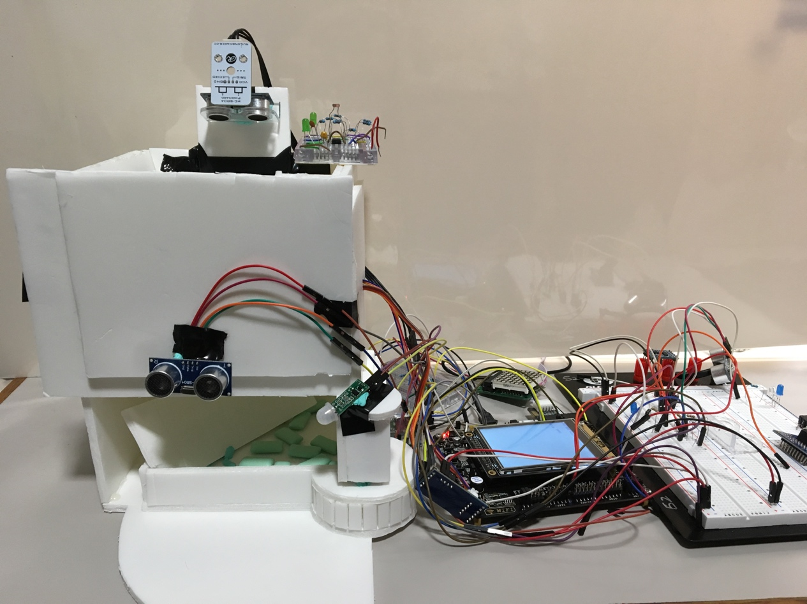
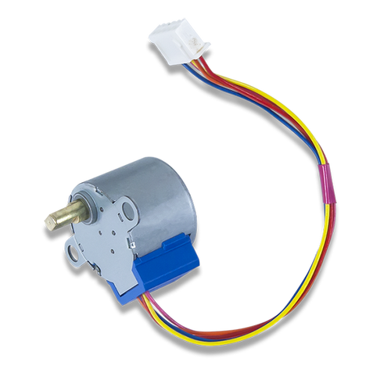
Project Ulterior Design
HC-SR04
LDR
LCD
Stepper Motor
Buzzer
PIR
Servo Motor

Slide 5
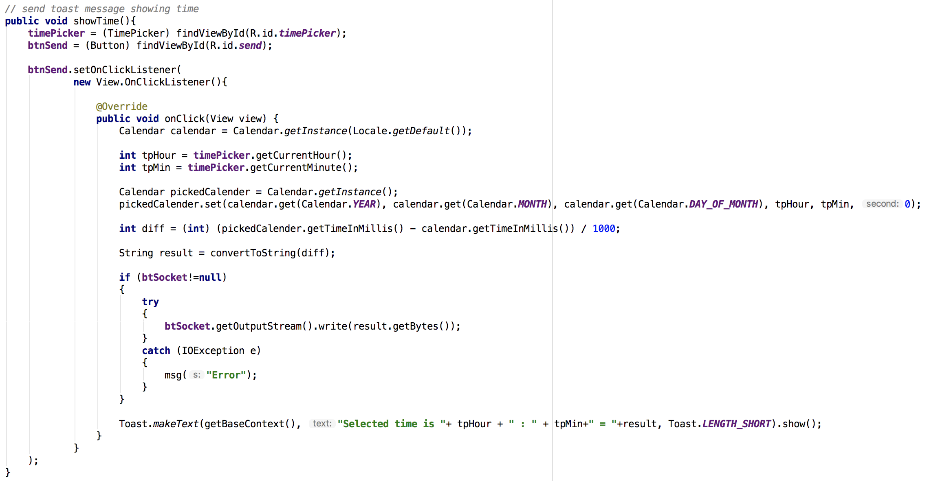
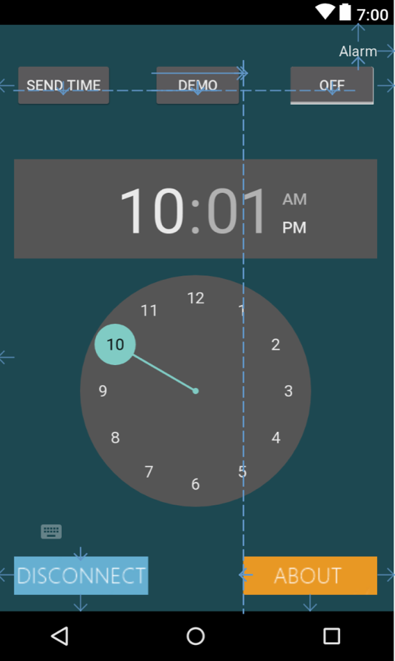
Android Application Structure

Slide 6
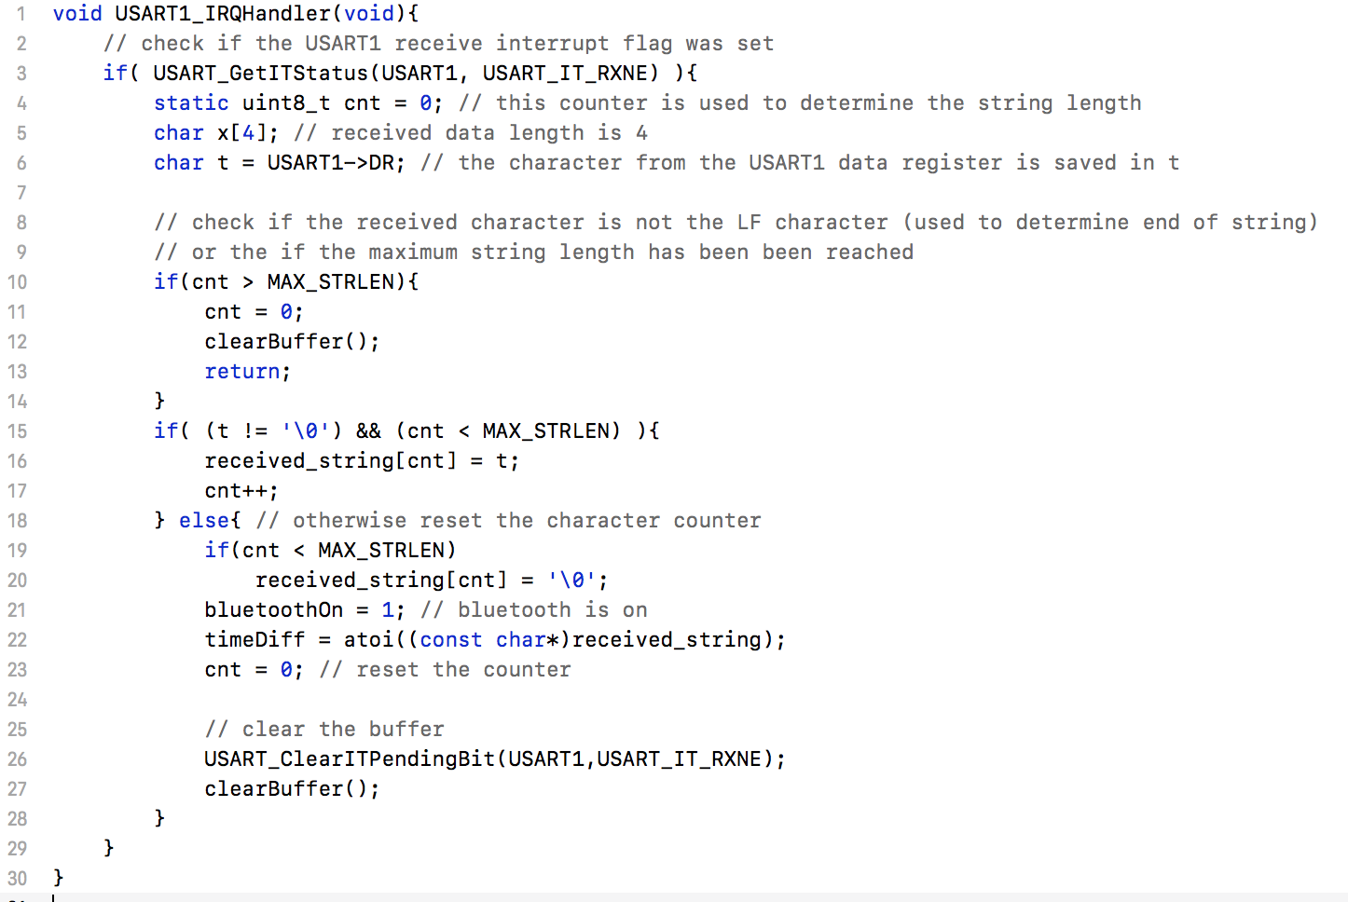
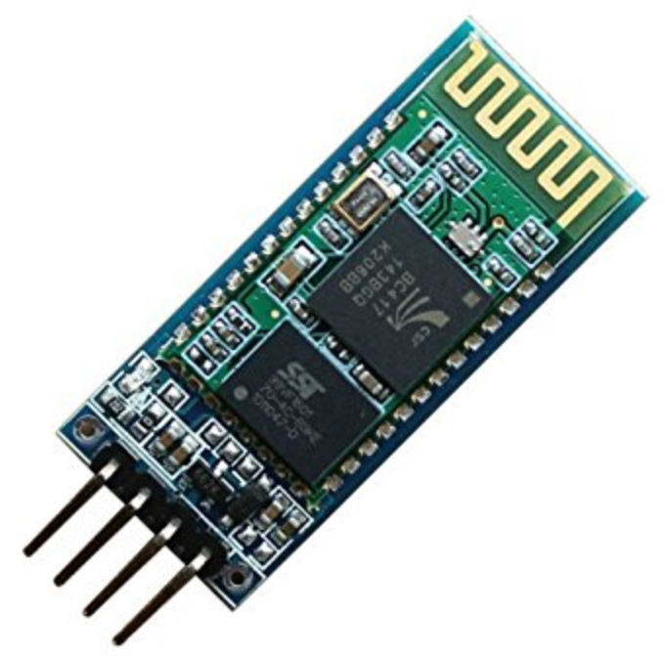
UART Implementation
(Bluetooth)HC-05

Slide 7
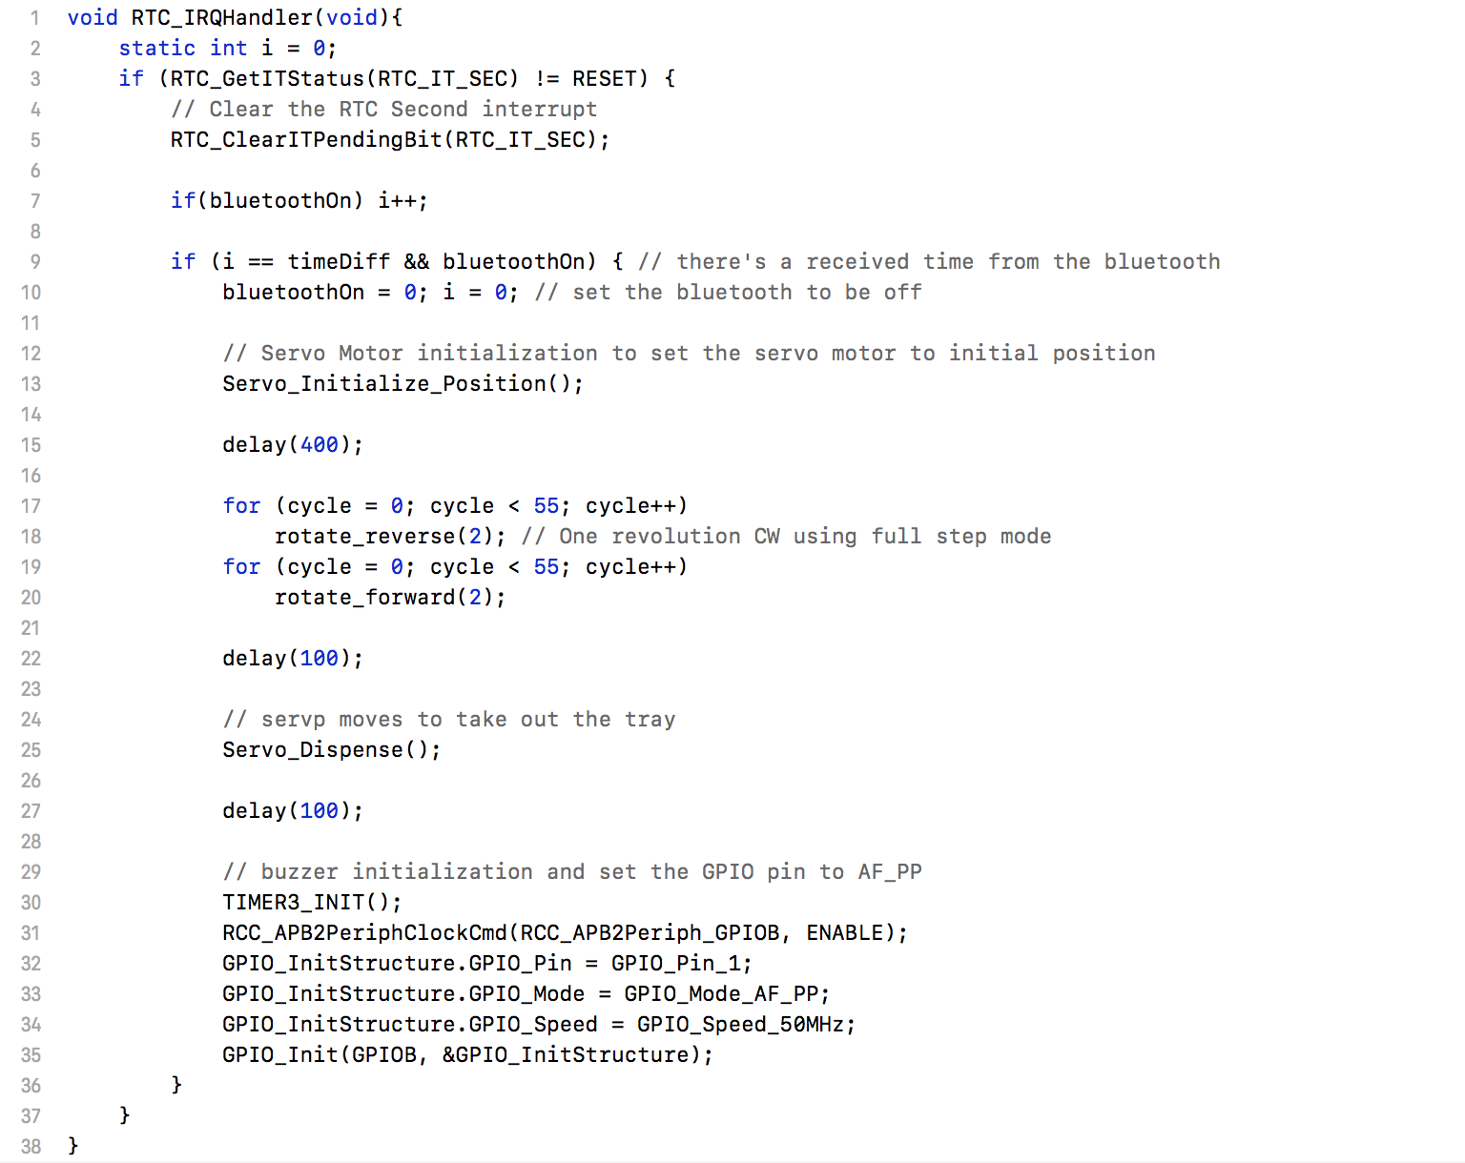
RTC Implementation

Slide 8
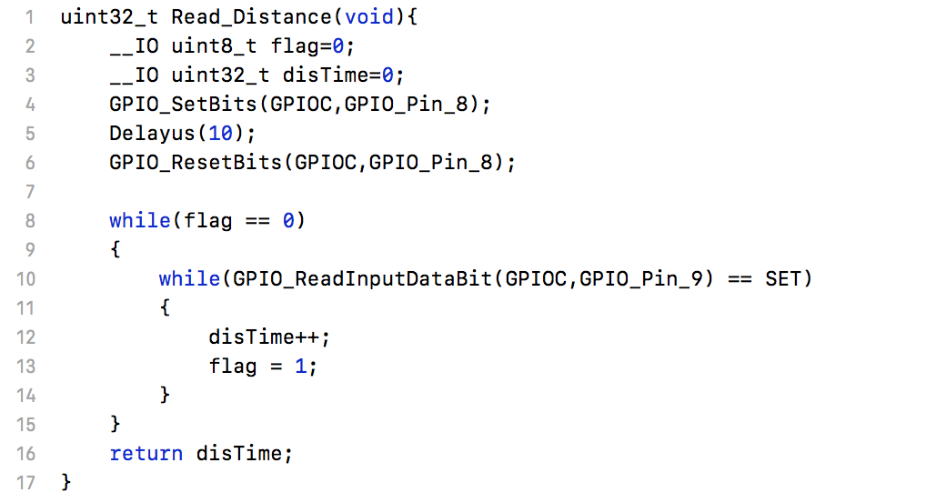
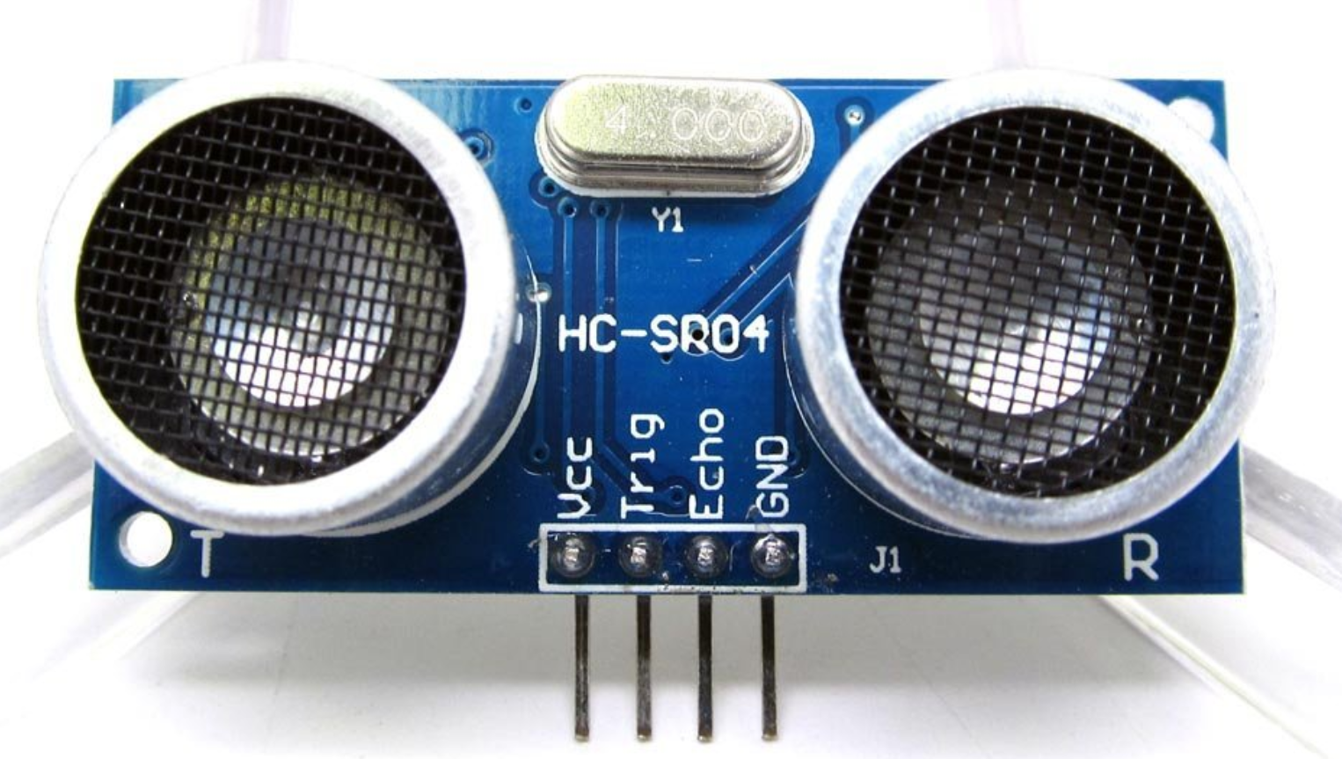
Ultrasonic Implementation
HC SR04 (Ultrasonic)

Slide 9
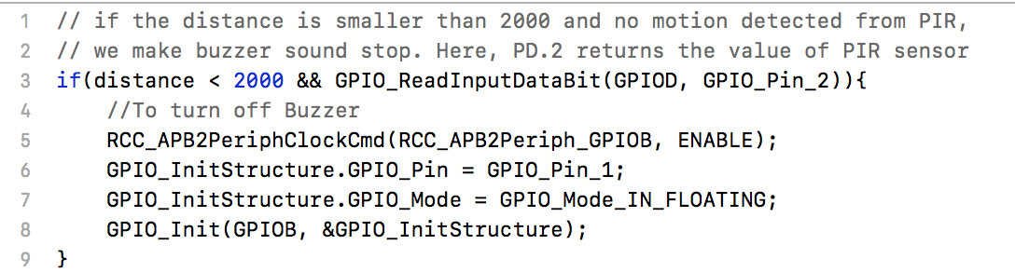
Buzzer Stop Implementation

Slide 10
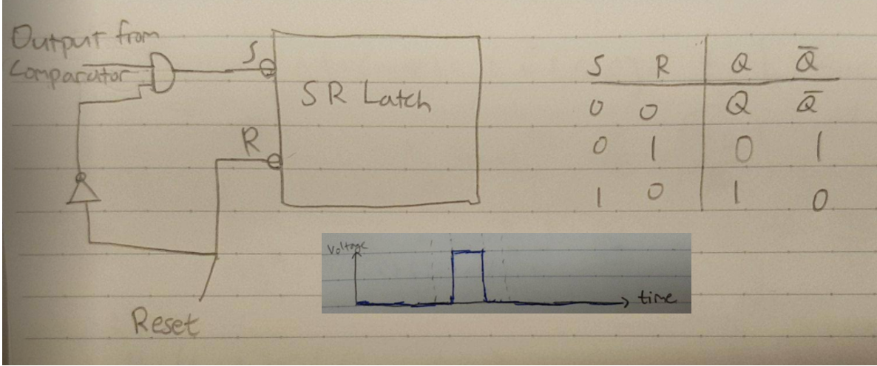
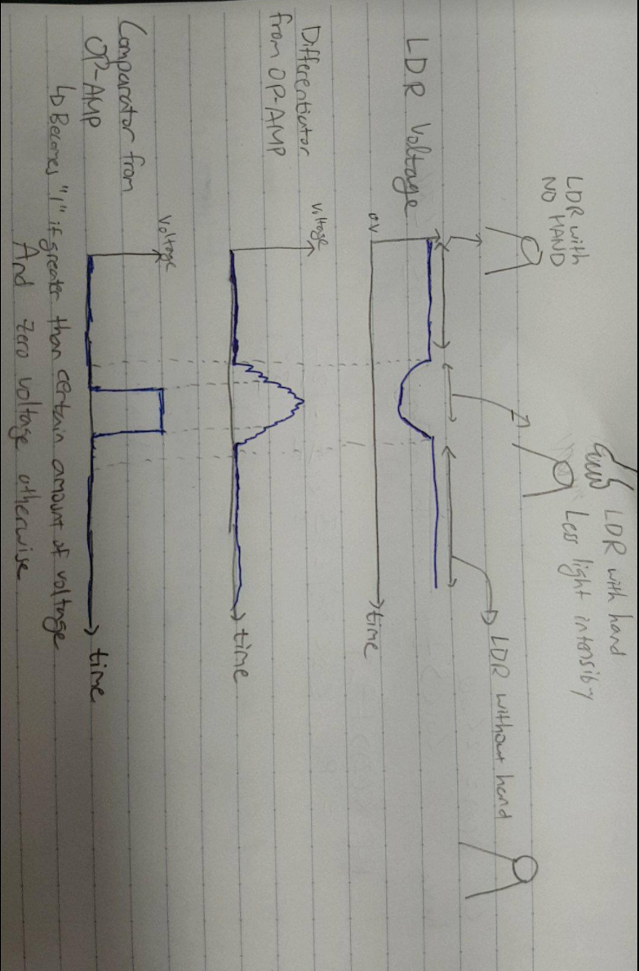
LDR Implementation

Slide 11

Limitation & Improvement
Saving photo taken by OV7725 into SD card
Difficulties of handling noise for LDR
Calibration of motors and structure design
Instability of HC 05

Slide 12
Q & A

